Slide 1
Wordle

Slide 2
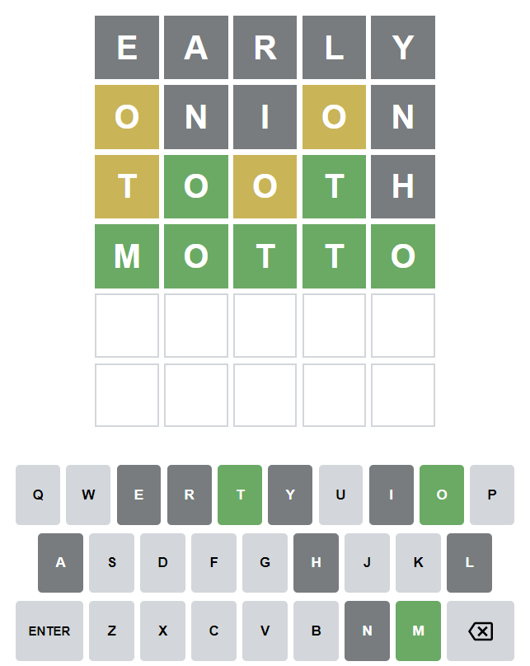
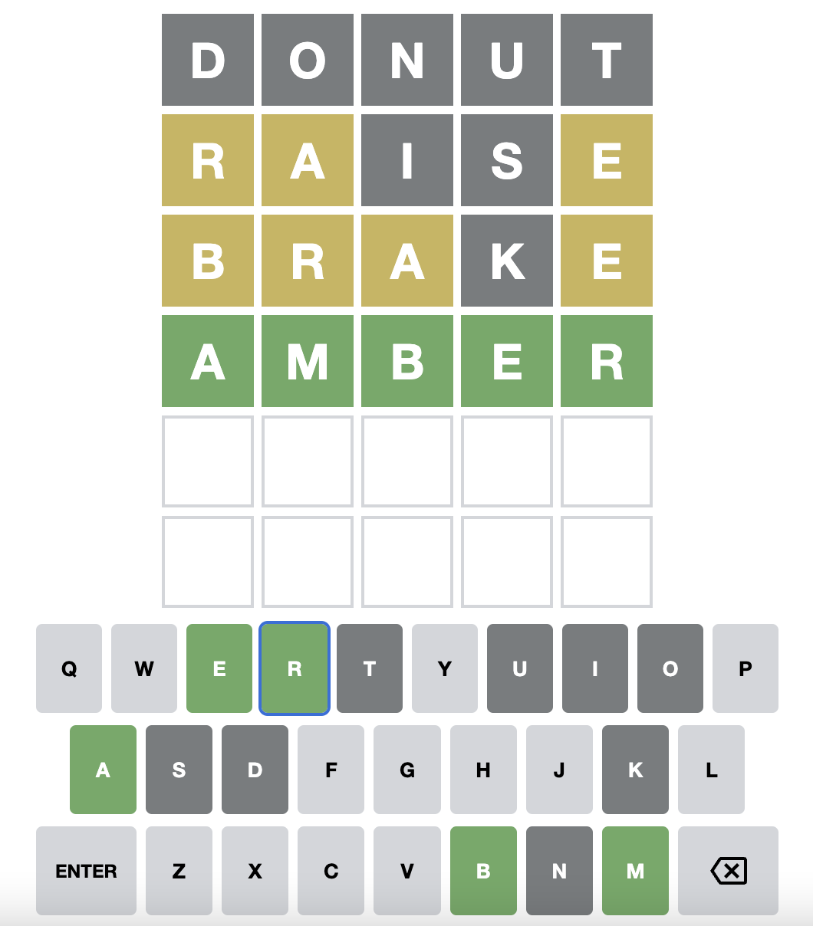
Wordle
Work with a partner to build a Terminal-based Wordle game.

Slide 3
Exercise 0: Wordle Design Discussion Questions
What are the rules for playing Wordle?
How does Wordle use color to provide feedback to players?
List at least six unique test cases for a single Wordle guess. What makes these good test cases?
What is an MVP for wordle?
Notes:
MVP = minimum viable product

Slide 4
Exercise 1: Correctly implement Wordle feedback.
You are free to design your own implementation of Wordle. However, you must include an implementation for the get_feedback function in wordle.py which will be tested on Gradescope:
Examples
–-------
>>> get_feedback("lever", "EATEN")
"-e-E-"
>>> get_feedback("LEVER", "LOWER")
"L--ER"
>>> get_feedback("MOMMY", "MADAM")
"M-m--"
>>> get_feedback("ARGUE", "MOTTO")
"-----"
Notes:
The Wordle MVP, along with some relevant test cases

Slide 5
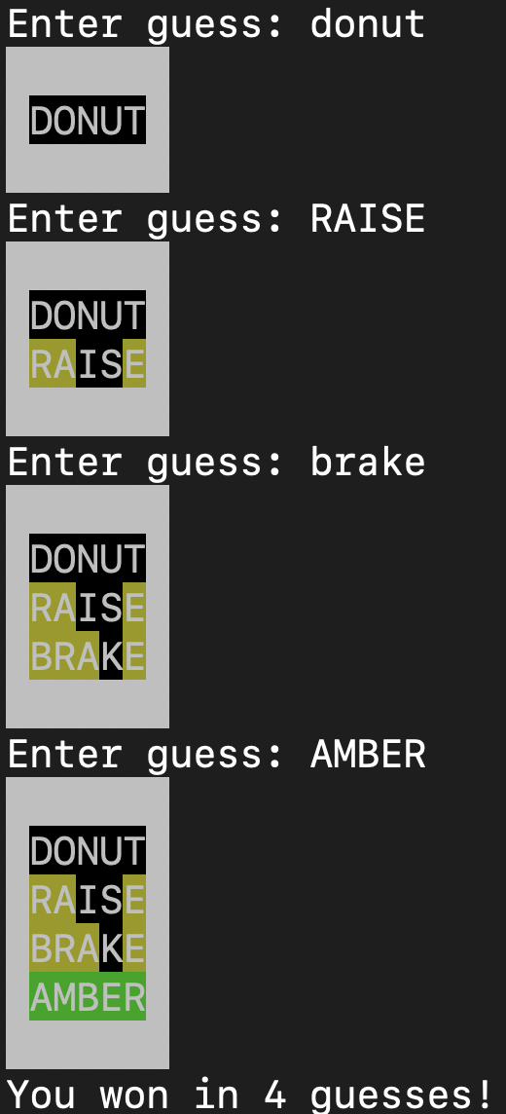
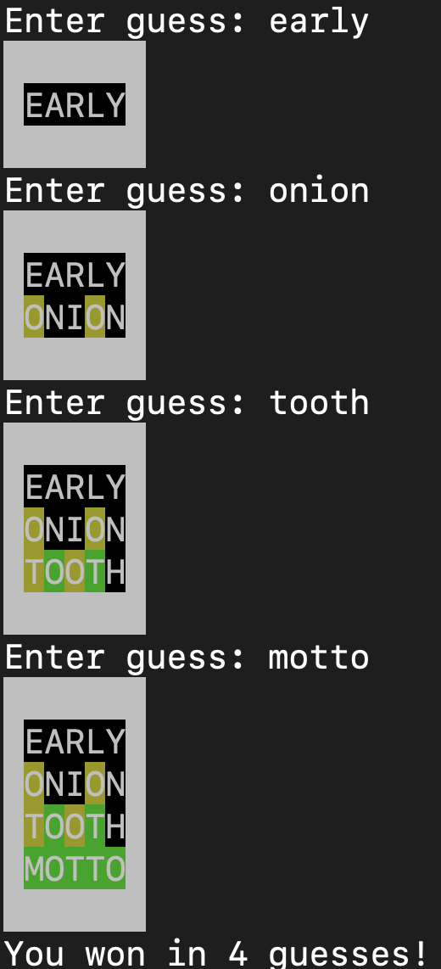
Exercise 2: Implement the full Wordle game.
Use the colorama library to display the list of guesses. Use the following background and foreground color combinations:
Green/Black: Correct letter in the correct position
Yellow/Black: Correct letter in the incorrect position
Black/White: Incorrect letter (i.e. not in the secret word)
A complete list of appropriately colored guessed words should be output at each turn, similar to the diagrams below.
Once you implement your AI function players should be able to get a hint by typing “h” or “H”
Notes:
Note: these screenshots are from an older version of colorama.

Slide 6
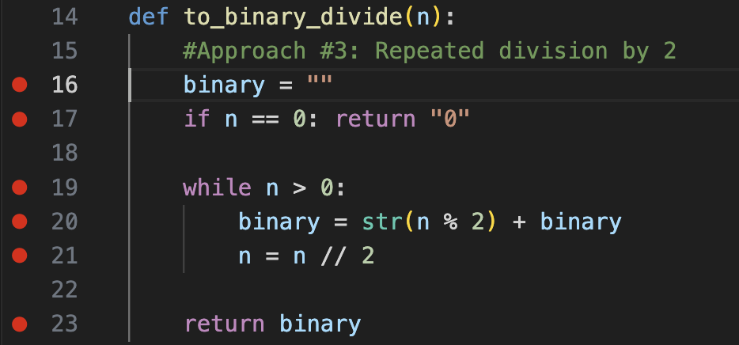


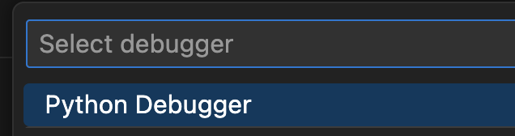
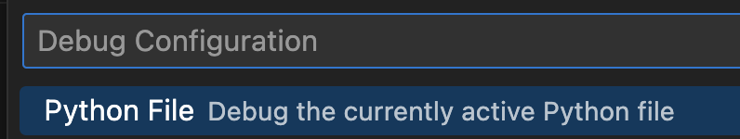

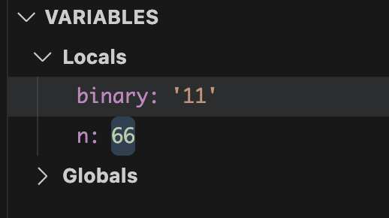
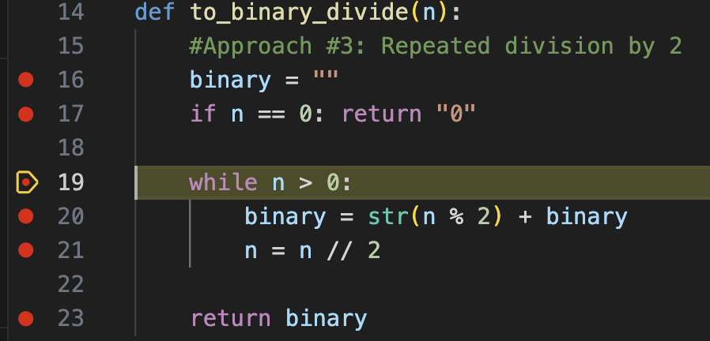
Set breakpoints on the important lines of code
Click on VSCode Run and Debug
Select (if necessary)
Python Debugger
Python File
Use the control panel to step through execution of your code:
This helps you break your algorithm down into “animation frames” according to where you’ve set breakpoints. This is very helpful in understanding variariable values and the overall path of execution of your code.
VSCode Debugging - binary_demo.py

Slide 7
Wordle AI

Slide 8
Discussion: Wordle AI design
What information would an AI need to make a guess?
What would be a good way to compare AI approaches?
What are a few different approaches the AI could take?
What data model would you use in your AI?

Slide 9
If element ordering and duplicates aren’t a concern, sets are probably faster.
 | List |  | Set
 | membership | remove | membership | remove
ABYSS | 0.0006 | 0.0032 | 0.000045 | 0.00012
BEGIN | 0.0073 | 0.0095 | 0.000041 | 0.00011
MOMMY | 0.0524 | 0.0549 | 0.000048 | 0.00012
NIGHT | 0.0565 | 0.0580 | 0.000058 | 0.00011
YUMMY | 0.0972 | 0.0982 | 0.000060 | 0.00013
ZORRO | 0.1011 | 0.0988 | 0.000060 | 0.00013
Avg Time in Seconds for 100 trials
Collections: Modifying lists vs sets deletion_comparison_demo.py
Notes:
Note: removing from a list in Python first requires looking up the index of the element

Slide 10
Managing Data Access scope_demo.py
Scope
Scope describes the section of code in which data can be accessed.
A variable created within a function has a local scope to that function.
To reference a variable from outside of a function Python requires the use of the global keyword
Python Parameters
Mutating methods produce changes to parameters within the body of a function.
Python functions allow for the use of optional parameters/arguments.

Slide 11
Exercise 3: Implement a Wordle AI
Implement the get_AI_guess function in wordle.py. This function will be called with the following inputs:
A list of guesses for the current game so far (between 0 - 5 guesses)
A list of feedback for the current game so far (between 0 - 5 feedback strings)
A set of potential Wordle secret words (~2,300 words)
A set of valid words for guessing the secret word (~13,000 words)
In your game, when a player types ‘H’ or ‘h’ instead of a 5-letter guess, invoke this method to suggest a good word to choose next based on the guesses and related feedback seen so far.
On Gradescope, a benchmark profiler will run this method in a game against every possible Wordle word. This will result in three leaderboard evaluation metrics:
Accuracy: The total percentage of games solved
Skill: The average number of guesses taken to solve a game
Time: The average time take for your procedure to determine a guess

